Slide 1
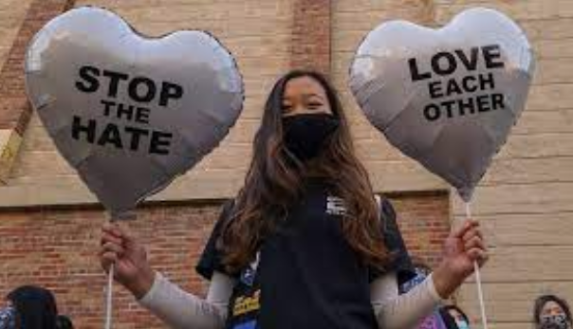
Hate Crimes

Slide 2
Hate Crime – defining it
Hate crime refers to unlawful, violent, destructive or threatening behaviour in which the perpetrator is motivated in whole or in part by prejudice towards the victim’s perceived race, ethnicity, religion, sexual orientation, gender identity, age, physical or other impairment or homelessness (Federal Bureau of Investigation, 2013)

Slide 3
What is a Hate Crime in Canada?
There’s a lot of confusion around this.
The Criminal Code of Canada does not include a specific section on Hate Crime, per se.
Instead, engaging in a crime that is motivated by hate is seen as an aggravating factor at sentencing
Two key elements of the offense:
A criminal offence must have occurred (e.g. an assault, damage to property, uttering threats etc.).
Hate or Bias toward a victim must have motivated the criminal offence (e.g. because of the victim's race, nationality, ethnicity, language, religion, sex, age, mental or physical disability, sexual orientation etc.).

Slide 4
3 exceptions
Section 318 - Advocating Genocide.
Section 319 (1) - Public Incitement of Hatred.
Section 319 (2) - Wilful Promotion of Hatred.

Slide 5
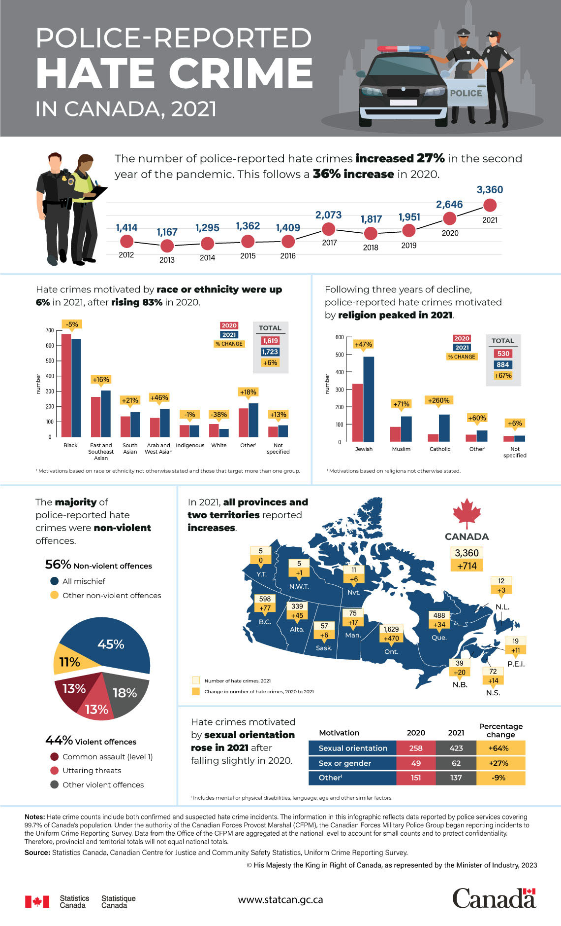

Slide 6
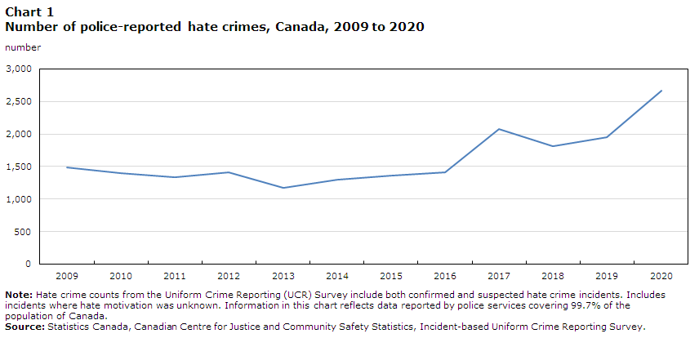

Slide 7
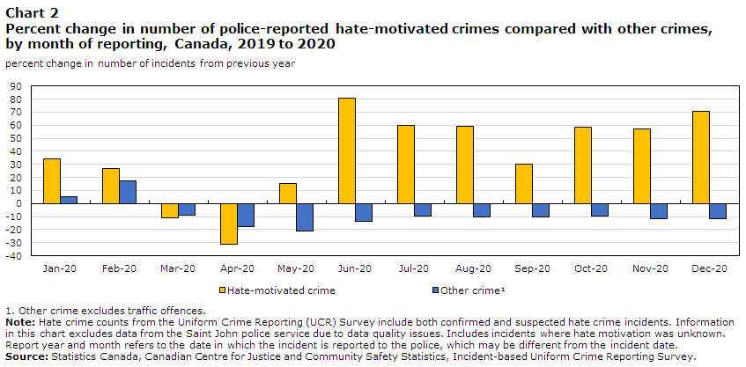

Slide 8
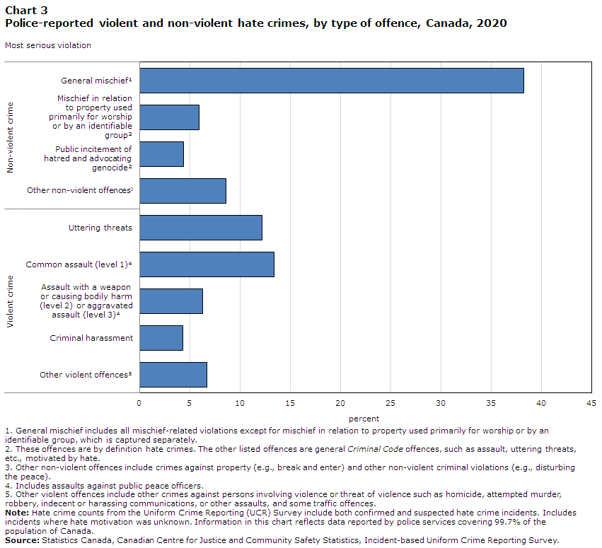

Slide 9
Victim experiences of hate crime
Rami: Everything changed when Vernon Majors moved in with the neighbor. He didn’t like our family, especially Khalid and my mom. He was filled with hate.
Victoria: When he first arrived at the house next door in 2011, he was angry that my brother had technology and computer equipment there. Majors threw out all of Khalid’s stuff. Hard drives, monitors, wires, and much more. Whatever was left there Khalid soon removed because Majors seemed to be in charge.
On another occasion, he came onto our property, took pictures of my mom cooking, and called the health department, asking for our business to be shut down. He claimed that we were preparing food for our business at home, which we were not.

Slide 10
Maan Singh Khalsa
On September 25, 2016, Maan Singh Khalsa suffered severe physical and emotional trauma after he was attacked by three men at a Richmond, California, intersection. He was stabbed in the hand so deeply that his finger needed to be amputated, and his eye was swollen shut from being beaten. His attackers pulled off his turban and cut his hair, attacking his very identity as a Sikh. At the sentencing hearing for his attackers, Mr. Khalsa testified, “It will take many years, maybe the rest of my life, to heal from this attack. Just recognizing it as a hate crime is the first step in healing.”

Slide 11
How bystanders view victims of hate crimes (Erentzen et al. 2021)
Participants read a scenario in which a White man verbally harassed a victim in the park before physically assaulting him. We manipulated both the victim’s identity (White or South Asian Muslim) and the victim’s response to the perpetrator’s verbal harassment (the victim either ignored the offensive comments, verbally reacted to them, or became physically confrontational).
When the victim was portrayed as passive and nonresponding, the South Asian Muslim victim attracted lower victim blame, higher perpetrator blame, and increased certainty that the offense was a hate crime.
As the victim’s behavior became more aggressive, victim blaming increased and perpetrator blaming decreased, but only for the South Asian Muslim victim.

Slide 12
Impacts on victims
Victims of hate crime report anger, nervousness, feeling unsafe, poor concentration and loss of self-confidence. While victims of non-hate crimes report similar feelings, harm is intensified for hate crime victims due to the targeted nature of the incident (Benier 2017).

Slide 13
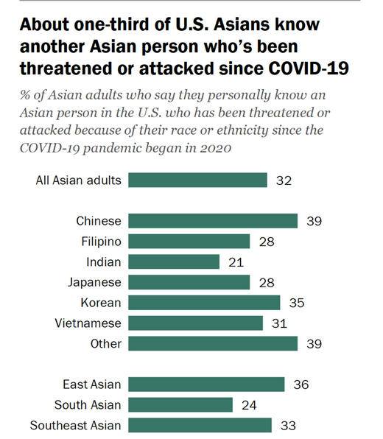
Pew 2023

Slide 14
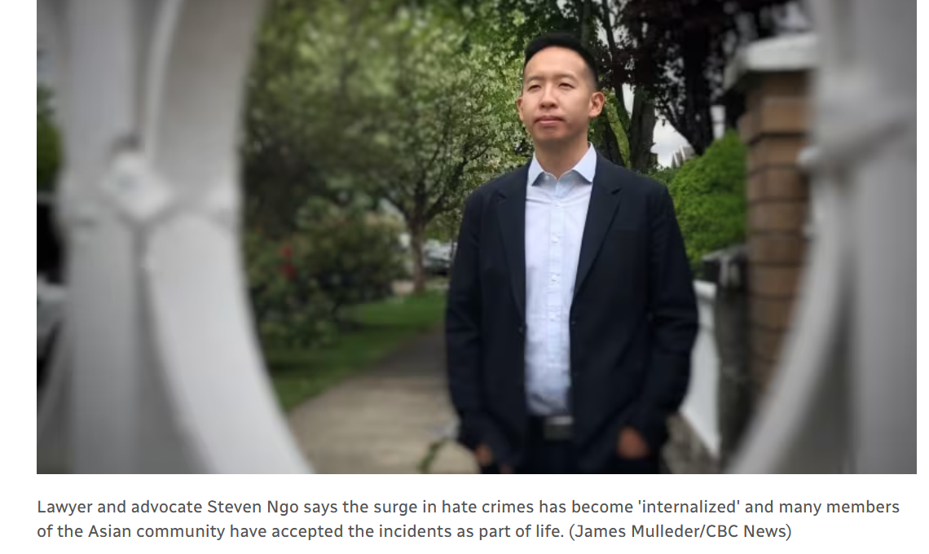
One huge negative impact: accepting the hate

Slide 15
While it is the case that most hate-motivated crimes in Canada are non-violent, there have been some horrendous examples of violent bias-motivated crimes.
Aaron Webster murder case
Quebec City mosque shooting

Slide 16
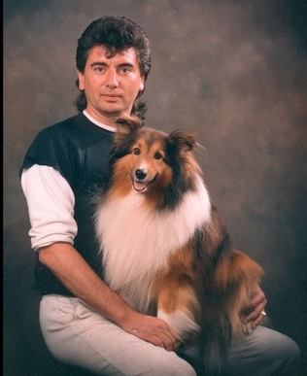
Aaron Webster (2001)
Aaron Webster was beaten to death by strangers in a secluded, wooded area of Stanley Park in the City of Vancouver.
Webster was found by his good friend and subsequently died in the man’s arms before being transported to hospital.
A year later, police received a tip identifying 4 suspects – one adult and three teens. One of the suspects had bragged about his participation.

Slide 17
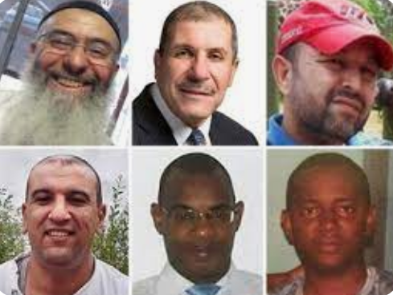
Quebec City Mosque Shooting
On January 29, 2017, an armed man entered a mosque during Friday evening prayers and began shooting, killing 6 and injuring 5 others.
Ibrahima Barry, 39, a Quebec government IT worker
Mamadou Tanou Barry, 42, an accounting technician
Khaled Belkacemi, 60, a professor at Universite de Laval
Aboubaker Thabti, 44, a pharmacy technician
Abdelkrim Hassane, 41, a computer analyst
Azzedine Soufiane, 57, a grocery store owner.

Slide 18
Hate Crimes on Campuses Santos and Yogev (2024)
https://www.youtube.com/watch?v=qBVhoevvCRA&feature=youtu.be

Slide 19

*all done!*

